Slide 1
Newdigate C of E Infant School
September 2022
‘Meet The Teacher: Information about learning and the curriculum.’

Slide 2
The adults in our class are…
Mrs Denyssen: Monday, Tuesday and Wednesday morning
Mrs Priestley: Wednesday afternoon, Thursday and Friday.
Mrs Llewellyn, Mrs Copus, Miss Cannon: Teaching Assistants: Monday-Friday

Slide 3
Newdigate CofE Infant School 2022-2023 Topics

Slide 4
The New Early Years Framework
Notes:
Unique child – likes/motivates/how we can help them
Relationships with parents
Assessing them – next steps, support
Prime Areas and Specific areas

Slide 5
Reading
Why is there a new reading framework?
“ Over the last 2 decades, there has been a deepening recognition of the fundamental importance of improving reading standards on a child’s future academic achievement, wellbeing and success in life” – Reading framework – 2021
“If children are confident and proficient readers at an early age, they have better educational outcomes and life chances” – Reading framework 2021
https://www.youtube.com/watch?v=LxU75zhNn0g
Notes:
Video link - Why is reading so important? Learn to read/read to learn If chn can read by the age of 6 – they are much more likely to have future academic success.
Play video from 8.24 – 10.52

Slide 6
Simple view of reading
Notes:
The simple view of reading is a scientific theory that a student's ability to understand written words depends on how well they sound out the words and understand the meaning of those words.
The aim is for all chn to be in the top right quadrant.

Slide 7
Scarborough reading rope
Notes:
Scarborough's Rope captures the complexity of learning to read.
Scarborough's Reading Rope is made up of lower and upper strands.
When all of these component parts intertwine - it results in skilled reading with accuracy, fluency, and strong comprehension.
From Reading Framework
“When children start learning to read, the number of words they can decode accurately is too limited to broaden their vocabulary.
Their understanding of language should therefore be developed through their listening and speaking while they are taught to decode.”

Slide 8
How can you help at home? 2 book formula
‘I read this book to you’ (child focuses on decoding)
Read, read and read!
Reading challenge
Focus on decoding – the framework says a child MUST be fluent in a given book before they can change it –so read and re read as much as possible (your child may use the pictures as a clue to the word – this is okay, however, guide them back to skill of decoding as a strategy for reading. As they become more advanced readers – there will be less pictures and they will need to use their phonic knowledge to feel secure about themselves as a ‘reader’ )
Please do write in the purple reading record –it helps us to see how your child is reading at home and we can respond as necessary.
Do come and talk to us if you have a question
‘You read this book to me’ (adult reading to child – language and comprehension)
First read - enjoy the story.
Later reads - the children can join in with key phrases, they can recall parts of the story, you can discuss the meanings of words and you will have modelled expression!

Slide 9
Reading Objectives
Reading forms an essential part of our school day
Individual reading
Phonics
Story time
Notes:
Books You Read to Me

Slide 10
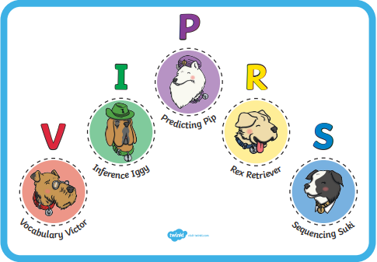
Reading Objectives
During our whole class and small group reading we will be focusing on developing their:
Inference
Sequencing
Predicting
Vocabulary
Retrieving information
Notes:
The totally pawsome gang – Vocabulary Victor, Rex Retriever, Predicting Pip, Inference Iggy, Sequencing Suki

Slide 11
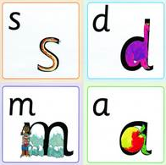
Phonics
We use a synthetic phonics programme to teach reading called ’Read Write Inc’ by Ruth Miskin.
‘RWI’ is a method of teaching reading centred around learning the sounds of the letters (phonics) and then blending them together to read words.
The children also learn to break down words into individual sounds in order to write them.
Notes:
Books You Read to Me

Slide 12
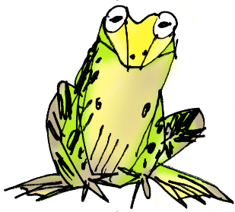
Phonics
Phoneme – spoken sounds – there are about 44 in the English language
Grapheme – how we write each of the spoken sounds e.g the spoken sounds ‘f’ is written using the graphemes f, ff, ph.
Red words – words that cannot be sounded out until the sound has been covered or use uncommon sound patterns e.g. come, you, was. We also call these ‘tricky words’.
Notes:
Books You Read to Me

Slide 13
Phonics
Fred talk – (Fred is the frog) he can only talk in sounds e.g. sh-o-p
Green Fred words – words that can be read out loud using our phonics. First we spot the ‘special friends’ then ‘Fred talk’ before we ‘say the word’ by blending the sounds together.
Fred in your head – silently look for ‘special friends’, then ‘Fred talk’ before saying the word out loud.
Speedy reading – reading green words on sight
Nonsense words – fluency measures a child's ability to decode individual phonemes and then blend them together to read. By using nonsense words, we can find out whether a child knows the most common sound for letters (letter–sound correspondence) and whether a child can blend the sounds to read words they have never seen before.
Notes:
Books You Read to Me

Slide 14
National Phonics Check
The National phonics screening check is a statutory assessment that was introduced in 2012 to all Year 1 pupils.
All year 1 pupils will take the phonics screening check in the Summer term.
It comprises of a list of 40 words; 20 real words and 20 nonsense words.
It will assess phonics skills and knowledge learnt through reception and year 1.
Your child will read the test in a one to one situation. They will read up to 4 words per page and they will probably do the check in 10‐15 minutes. They will be asked to ‘sound out’ a word and blend the sounds together to read the word. The children have plenty of exposure to nonsense words so they are well prepared for the test.
Notes:
Books You Read to Me

Slide 15
Literacy Early Learning Goals
By the end of Reception:
Comprehension
Demonstrate an understanding of what has been read to them by retelling stories and narratives using their own words and recently introduced vocabulary;
Anticipate key events in stories;
Use and understand recently introduced vocabulary during discussion about stories, non-fiction, rhymes and poems and during role-play.
Notes:
End of year – report to you whether or not met ELGs – Emerging or Expected
Within these styles of writing we starting to secure using capital letters, finger spaces and full stops in sentence writing.
show improvements we do this using Purple Pen.

Slide 16
Literacy Early Learning Goals
By the end of Reception:
Word Reading
Say a sound for each letter of the alphabet and at least 10 digraphs;
Read words consistent with their phonic knowledge by sound blending;
Read aloud simple sentences and books, including some tricky words.
Children are encouraged to use a sound mat to enable them to become independent writers.
Notes:
show improvements we do this using Purple Pen.

Slide 17
Literacy Early Learning Goals
By the end of Reception:
Writing
Write recognisable letters, most of which are correctly formed;
Spell by segmenting the sounds in a words;
Write simple phrases and sentences that can be read by others.
Notes:
show improvements we do this using Purple Pen.

Slide 18
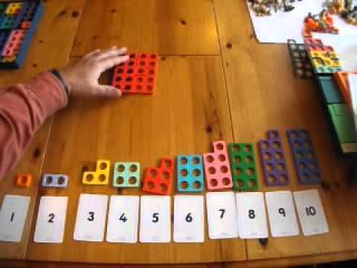
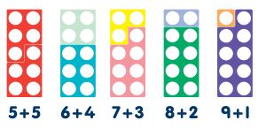
Mathematics Early Learning Goals
By the end of Reception:
Number
Have a deep understanding of numbers to 10, including the composition of each number;
Subitise (recognise quantities without counting) up to 5;
Recall by heart number bonds up to 5 (including subtraction facts) and some number bonds to 10, including doubling.
Notes:
show improvements we do this using Purple Pen.

Slide 19
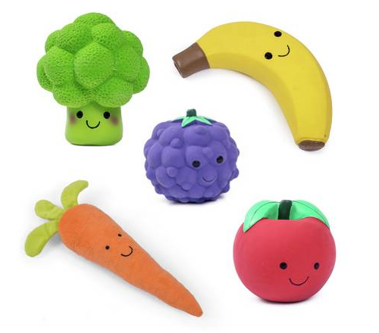
Subitise

Slide 20
Mathematics Early Learning Goals
By the end of Reception:
Numerical Patterns
Verbally count beyond 20, recognising the pattern of the counting system;
Compare quantities up to 10 in different contexts;
Explore and represent patterns within numbers up to 10, including even and odds, double facts and how quantities can be distributed equally.
Notes:
show improvements we do this using Purple Pen.

Slide 21
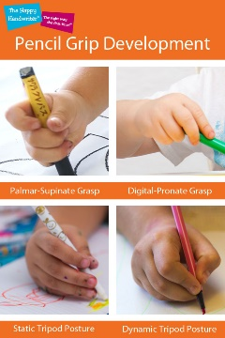
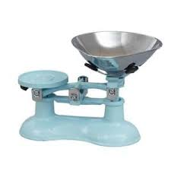
At home
Learning phonemes – letter sounds and digraphs.
‘Read to you’ (reading scheme book) ‘Read to me’ (quality book) 4 times a week
Home Learning Book
Encourage mark making, writing name and other words using correct pencil grip - Frog sitting on a log!
Orchard games
Encourage imagination
Resources e.g. Bath crayons, shaving cream, chunky chalk
Cooking
Gardening/being outside (measurements, seasons, shapes)
Shopping/playing shops (money, making totals)
Number bonds to 5 and 10
Count in 1s, 2s, & 10s forwards/backwards

Slide 22
Events
MacMillan Coffee Afternoon, this Friday 3.10 p.m. School Hall
Harvest Festival – 20th October 2:00pm
Parent Consultations – 9th and 16th November
Christmas Fair – 3rd December
Christmas Performance – 6th and 7th December
Christmas Jumper Day - 9th December
Christingle at St Peters Church – 15th December
Last day of term – 16th December

Slide 23
Homework
Daily reading – to be recorded in purple Reading Journals ‘I read to you’ – front of book
‘You read to me’ – back of book
Homework Books
Phonics
Maths
Sometimes:
Talk/practical home work linked with Topic

Slide 24
Tapestry
Tapestry is an online journal to help record all the learning and fun of children's early years education.
A two way process

Slide 25
Key Information
Children are allowed to bring in topic related objects and work to show. Please support us in not allowing your child to bring in toys to school. The Children take it in turns to take home, ‘what’s in the box!’ They are allowed to put anything in this box, including toys.
Parents of the birthday children are invited in for Birthday Assembly.
Children need water bottles in school each day - no juice/squash.
Please label everything including water bottles
Please can your child have wellington boots and jogging bottoms.
Free fruit in school scheme.
Milk and more – free for under 5s.
Please check newsletters for dates of forthcoming events.
Home circumstances – we are here to help.
ELSA – Emotional Literacy Support Assistant – Mrs Holt Miller

Slide 26
Thank you! Any questions?
September 2022
‘Meet The Teacher: Information about learning and the curriculum.’
Notes:
We want your children to become happy, confident and independent learners. who enjoy school and love learning. We want to give them strong foundations ready for moving into Year 1 and their time at school.

