Slide 1
Newdigate C of E Infant School
September 2022
‘Meet The Teacher: Information about learning and the curriculum.’

Slide 2
The adults in our class are…
Class teacher: Miss Haydon
Monday afternoons: Mrs Stewart PPA cover – Forest School specialist and music
Teaching assistants:
Miss Cannon morning support
Mrs Woods afternoon support
Mrs Holt – Miller intervention support and ELSA support

Slide 3
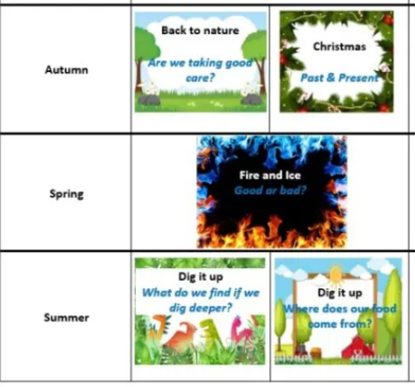
Newdigate CofE Infant School 2022 – 2023 Topics

Slide 4
Simple view of reading
Notes:
The simple view of reading is a scientific theory that a student's ability to understand written words depends on how well they sound out the words and understand the meaning of those words.
The aim is for all chn to be in the top right quadrant.

Slide 5
Scarborough reading rope
Notes:
Scarborough's Rope captures the complexity of learning to read.
Scarborough's Reading Rope is made up of lower and upper strands.
When all of these component parts intertwine - it results in skilled reading with accuracy, fluency, and strong comprehension.
From Reading Framework
“When children start learning to read, the number of words they can decode accurately is too limited to broaden their vocabulary.
Their understanding of language should therefore be developed through their listening and speaking while they are taught to decode.”

Slide 6
How can you help at home? 2 book formula
‘I read this book to you’ (child focuses on decoding)
Read, read and read!
Reading challenge
Focus on decoding – the framework says a child MUST be fluent in a given book before they can change it –so read and re read as much as possible (your child may use the pictures as a clue to the word – this is okay, however, guide them back to skill of decoding as a strategy for reading. As they become more advanced readers – there will be less pictures and they will need to use their phonic knowledge to feel secure about themselves as a ‘reader’ )
Please do write in the purple reading record –it helps us to see how your child is reading at home and we can respond as necessary.
Do come and talk to us if you have a question
‘You read this book to me’ (adult reading to child – language and comprehension)
First read - enjoy the story.
Later reads - the children can join in with key phrases, they can recall parts of the story, you can discuss the meanings of words and you will have modelled expression!

Slide 7
Reading in the school day
Phonics intervention for children who need to secure their phonetic sounds
Small group guided reading session once a week
1:1 reading to an adult once a week
End of the day story time
Whole class guided reading which builds up throughout the year starting at 2 times a week
Reading opportunities across the curriculum
Notes:
Books You Read to Me

Slide 8
Reading Objectives
Within Guided reading sessions and story time we will be focusing on developing their:
Inference
Sequencing
Predicting
Vocabulary
Retrieving information
Notes:
Books You Read to Me

Slide 9
English Objectives
In Year 2 we will be covering lots of different styles of writing including:
Letter writing
Diary entries
Newspaper articles
Non-chronological Reports
Recounts of stories
Poetry
Posters
Drawing upon vocabulary from their reading or what they have listened to!
Notes:
Within these styles of writing we are continuing to secure using capital letters and full stops in sentence writing. Especially as in Year 2 they need to extend their writing as they will be writing multiple sentences and writing in paragraphs.
When writing in different styles we will be planning our writing in detail, writing in the given style and then a focus in Year 2 is editing their work and at Newdigate to evidence the editing and show improvements we do this using Purple Pen.

Slide 10
English Objectives- SPAG
Gaps from Year One:
Identifying adjectives, verbs and nouns
Using capital letters and full stops fluently when writing extended pieces
Understand and fluently use conjunctions
Year 2 Objectives:
Using/ identifying apostrophes
Understanding suffixes
Identifying sentence types
Use commas correctly
Notes:
Current focus is phonics but we will then progress to focus on Spelling, Punctuation and Grammar

Slide 11
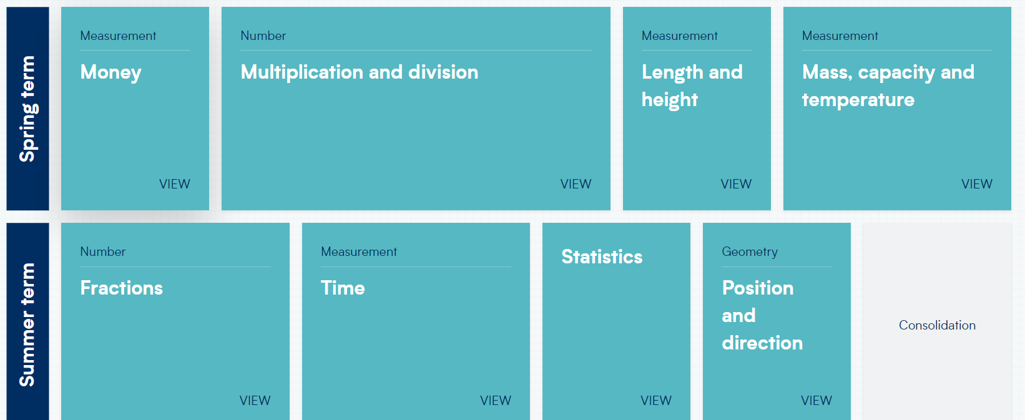
Math Objectives
Notes:
We follow White Rose and this shows the Long term plan of what we will be covering in maths and when. The white rose scheme of work is free and available online.
How we implement it is using the following process;

Slide 12
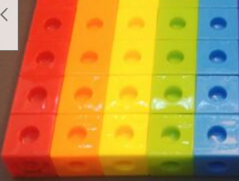
Maths at Newdigate
We work with concrete resources first for example numicon, diennes or nature!
We would then work pictorially using representations to support our understanding.
This process would happen over multiple lessons and then children would begin to work abstractly, working things out in their head.
4 x 5 = 20

Slide 13
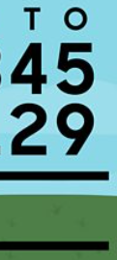
Math objectives
Fluency with number bonds to 10 and 20
Number formation
The importance of securing it:

Slide 14
Math Objectives to work on a home
Learning the time to the nearest 5 minutes – start with o’clock, half past and build up to 15 minutes and then 5 minutes
Multiplication and division facts for 2s, 5s and 10. Start practising counting in 2s, 5s and 10s!
Money and making equal amounts!

Slide 15
Foundation Subjects
Science:
Animals including humans- all about survival!
Material
Plants and Seeds
Computing:
Creating a documents, typing and saving work.
RE:
What is a Christian?
Why is the bible important?
What is important for a Muslim child?
Why did Jesus tell Parables?
DT:
Moving vehicles
Designing castles
PE:
Team building
Ball skills – feet and hand
Dance
Gymnastics
Yoga
Music and Drama:
Productions, songs, keeping a beat.
Geography:
Continents and oceans
Map work and fieldwork
Comparing places
Location and direction
Well being
Emotions, fire safety, private parts, growth mindset, voting and British values
History
Changes within living memory s
Significant historical events
Events beyond living memory

Slide 16
Events Being a Year 2 leader
MacMillan Coffee Afternoon, this Friday 3.10 p.m. School Hall
Harvest Festival – 20th October 2:00pm
Parent Consultations – 9th and 16th November
Christmas Fair – 3rd December
Christmas Performance – 6th and 7th December
Christmas Jumper Day - 9th December
Christingle at St Peters Church – 15th December
Last day of term – 16th December

Slide 17
Homework
Spellings – tested on a Wednesday
Daily reading – to be recorded in purple Reading Journals ‘I read to you’ – front of book
‘You read to me’ – back of book
Maths homework
Set fortnightly and collect in using the folder system so I can mark the previous week

Slide 18
Thank you! Any questions?
September 2022
‘Meet The Teacher: Information about learning and the curriculum.’

