Slide 1
Newdigate C of E Infant School
September 2022
‘Meet The Teacher: Information about learning and the curriculum.’

Slide 2
The adults in our class are…
Miss Langthorne :Monday, Tuesday and Wednesday morning
Miss Hill: Wednesday afternoon, Thursday and Friday.
Mrs Finn: Monday-Friday Mornings
Mrs Tomkins: Monday-Friday afternoons

Slide 3
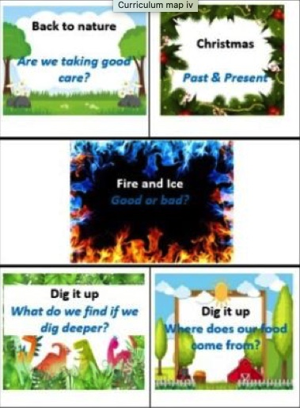
Newdigate CofE Infant School 2022 – 2023 Topics
Autumn
Spring
Summer

Slide 4
Reading
Why is there a new reading framework?
“ Over the last 2 decades, there has been a deepening recognition of the fundamental importance of improving reading standards on a child’s future academic achievement, wellbeing and success in life” – Reading framework – 2021
“If children are confident and proficient readers at an early age, they have better educational outcomes and life chances” – Reading framework 2021
https://www.youtube.com/watch?v=LxU75zhNn0g
Notes:
Video link - Why is reading so important? Learn to read/read to learn If chn can read by the age of 6 – they are much more likely to have future academic success.
Play video from 8.24 – 10.52

Slide 5
Simple view of reading
Notes:
The simple view of reading is a scientific theory that a student's ability to understand written words depends on how well they sound out the words and understand the meaning of those words.
The aim is for all chn to be in the top right quadrant.

Slide 6
Scarborough reading rope
Notes:
Scarborough's Rope captures the complexity of learning to read.
Scarborough's Reading Rope is made up of lower and upper strands.
When all of these component parts intertwine - it results in skilled reading with accuracy, fluency, and strong comprehension.
From Reading Framework
“When children start learning to read, the number of words they can decode accurately is too limited to broaden their vocabulary.
Their understanding of language should therefore be developed through their listening and speaking while they are taught to decode.”

Slide 7
How can you help at home? 2 book formula
‘I read this book to you’ (child focuses on decoding)
Read, read and read!
Reading challenge
Focus on decoding – the framework says a child MUST be fluent in a given book before they can change it –so read and re read as much as possible (your child may use the pictures as a clue to the word – this is okay, however, guide them back to skill of decoding as a strategy for reading. As they become more advanced readers – there will be less pictures and they will need to use their phonic knowledge to feel secure about themselves as a ‘reader’ )
Please do write in the purple reading record –it helps us to see how your child is reading at home and we can respond as necessary.
Do come and talk to us if you have a question
‘You read this book to me’ (adult reading to child – language and comprehension)
First read - enjoy the story.
Later reads - the children can join in with key phrases, they can recall parts of the story, you can discuss the meanings of words and you will have modelled expression!

Slide 8
Reading Objectives
Reading forms an essential part of our school day
Individual reading
Phonics
Story time
Small group reading
Notes:
Books You Read to Me

Slide 9
Reading Objectives
During our whole class and small group reading we will be focusing on developing their:
Inference
Sequencing
Predicting
Vocabulary
Retrieving information
Notes:
The totally pawsome gang – Vocabulary Victor, Rex Retriever, Predicting Pip, Inference Iggy, Sequencing Suki

Slide 10
Vocabular Victor
Uncle Bill put lots of heavy bags in his new car. Which word in the sentence describes the bags?
Notes:
The totally pawsome gang – Vocabulary Victor, Rex Retriever, Predicting Pip, Inference Iggy, Sequencing Suki

Slide 11
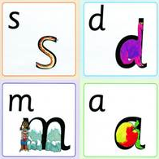
Phonics
We use a synthetic phonics programme to teach reading called ’Read Write Inc’ by Ruth Miskin.
‘RWI’ is a method of teaching reading centred around learning the sounds of the letters (phonics) and then blending them together to read words.
The children also learn to break down words into individual sounds in order to write them.
Notes:
Books You Read to Me

Slide 12
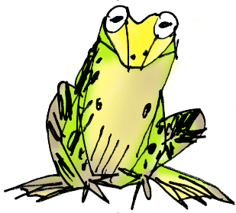
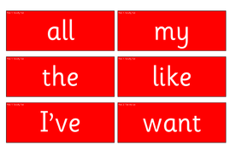
Phonics
Phoneme – spoken sounds – there are about 44 in the English language
Grapheme – how we write each of the spoken sounds e.g the spoken sounds ‘f’ is written using the graphemes f, ff, ph.
Red words – words that cannot be sounded out until the sound has been covered or use uncommon sound patterns e.g. come, you, was. We also call these ‘tricky words’.
Notes:
Books You Read to Me

Slide 13
Phonics
Fred talk – (Fred is the frog) he can only talk in sounds e.g. sh-o-p
Green Fred words – words that can be read out loud using our phonics. First we spot the ‘special friends’ then ‘Fred talk’ before we ‘say the word’ by blending the sounds together.
Fred in your head – silently look for ‘special friends’, then ‘Fred talk’ before saying the word out loud.
Speedy reading – reading green words on sight
Nonsense words – fluency measures a child's ability to decode individual phonemes and then blend them together to read. By using nonsense words, we can find out whether a child knows the most common sound for letters (letter–sound correspondence) and whether a child can blend the sounds to read words they have never seen before.
Notes:
Books You Read to Me

Slide 14
National Phonics Check
The National phonics screening check is a statutory assessment that was introduced in 2012 to all Year 1 pupils.
All year 1 pupils will take the phonics screening check in the Summer term.
It comprises of a list of 40 words; 20 real words and 20 nonsense words.
It will assess phonics skills and knowledge learnt through reception and year 1.
Your child will read the test in a one to one situation. They will read up to 4 words per page and they will probably do the check in 10‐15 minutes. They will be asked to ‘sound out’ a word and blend the sounds together to read the word. The children have plenty of exposure to nonsense words so they are well prepared for the test.
Notes:
Books You Read to Me

Slide 15
English Objectives
In Year 1 we will be covering lots of different styles of writing including:
Writing labels, lists and captions
Information sheets
Retelling familiar and traditional stories – including fairy tales, familiar settings and stories with repetitive language
Non-chronological Reports
Poetry and nursery rhymes
Posters
Notes:
Within these styles of writing we starting to secure using capital letters, finger spaces and full stops in sentence writing. Talk about RWI get writing
show improvements we do this using Purple Pen.

Slide 16
Spelling
Spelling – children are encouraged to use a sound mat and ‘Fred fingers’ from the RWI programme
After Autumn half term - Year 1 spellings to be stuck in purple reading records. Parents to check and tick when your child can confidently:
Read the word
Spell the word
Spell the word in a simple sentence (this can be a dictated sentence)
We will then give your child the next set of words.

Slide 17
Maths Objectives
Notes:
We follow White Rose and this shows the Long term plan of what we will be covering in maths and when. The white rose scheme of work is free and available online.
How we implement it is using the following process;

Slide 18
Math at Newdigate
We work with concrete resources first for example numicon, diennes or nature!
We would then work pictorial using representations to support our understanding.
This process would happen over multiple lessons and then children would begin to work abstractly, working things out in their head.

Slide 20
Math objectives
Autumn Term – Number – place value and addition and subtraction to 20.
Shape – 3d and 2d shapes
How number is broken down:
The National Curriculum states that children in Year 1 should be able to count, read and write numbers to 100 by the end of the year. To make this more accessible the objective has been broken down into more manageable stages. Children cover place value to 10 in Autumn 1, to 20 in Autumn 2, to 50 in spring and to 100 in Summer. This helps ensure that skills are deeply embedded and built up slowly, over time.
Notes:
Although children have worked with numbers to 20 in Early Years there is no expectation that they should be able to formally record them. Some Year 1 children might therefore be recording numerals for the first time. With numbers to 10 forming the basis of our number system, it’s important that children develop a strong sense of number and can confidently use them in different ways, e.g. knowing every number bond to 10.

Slide 21
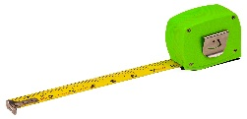
Maths at home
Tell the time
Cooking (measuring, fractions, timing, temperature)
Gardening (measurements, seasons, shapes)
DIY (measurements, counting)
Shopping (money, making totals)
Number bonds to 10 and then 20
Count in 1s, 2s, 5s & 10s forwards/backwards

Slide 22
Foundation Subjects
Science:
Our Body
Animals
Materials
Weather and Seasons
Plants and Seeds
Art:
Developing skills and knowledge through our topic
RE:
Who is God?
What is the Bible about?
Gifts at Christmas
Judaism and Jewish festivals?
Easter
Who is Jesus?
What is a Church?
DT:
Moving pictures
Food – fruit and vegetables
Designing castles
Geography:
Continents and oceans
Map work and fieldwork
Comparing places
Location and direction
History:
Changes within living memory – transport, family
Significant individuals - Amelia Earhart, Bessie Coleman, Queens
Significant historical events
Events beyond living memory
PE:
Netball
Dance
Gymnastics
Athletics
Cricket
Orienteering
Music and Drama:
Productions, songs, keeping a beat.

Slide 23
Events
Hello Yellow Day – October
Harvest Festival- 20th October
INSET – 21st October
Parent Consultations – 9th and 16th November
Christmas Performance – 6th and 10th December
Christingle at St Peters Church –15th December
Last day of term –16th December

Slide 24
Homework
Daily reading – to be recorded in purple Reading Journals ‘I read to you’ – front of book
‘You read to me’ – back of book
Spelling lists to go home after Autumn term
Homework Books
Phonics
Sentence work
Maths
Sometimes:
Talk/practical home work linked with Topic

Slide 25
Thank you! Any questions?
September 2022
‘Meet The Teacher: Information about learning and the curriculum.’

