Slide 2
Newdigate CofE Infant School Reading framework
Why is there a new reading framework?
“ Over the last 2 decades, there has been a deepening recognition of the fundamental importance of improving reading standards on a child’s future academic achievement, wellbeing and success in life” – Reading framework – 2021
“If children are confident and proficient readers at an early age, they have better educational outcomes and life chances” – Reading framework 2021
https://www.youtube.com/watch?v=LxU75zhNn0g
Notes:
Video link - Why is reading so important? Learn to read/read to learn If chn can read by the age of 6 – they are much more likely to have future academic success.
Play video from 8.24 – 10.52

Slide 3
Newdigate CofE Infant School Reading framework
Here’s how many words children would have heard by the time they were 5 years old:
Never read to, 4,662 words;
1–2 times per week, 63,570 words;
3–5 times per week, 169,520 words;
daily, 296,660 words;
and five books a day, 1,483,300 words.

Slide 4
Simple view of reading
Notes:
The simple view of reading is a scientific theory that a student's ability to understand written words depends on how well they sound out the words and understand the meaning of those words.
The aim is for all chn to be in the top right quadrant.

Slide 5
Scarborough reading rope
Notes:
Scarborough's Rope captures the complexity of learning to read.
Scarborough's Reading Rope is made up of lower and upper strands.
When all of these component parts intertwine - it results in skilled reading with accuracy, fluency, and strong comprehension.
From Reading Framework
“When children start learning to read, the number of words they can decode accurately is too limited to broaden their vocabulary.
Their understanding of language should therefore be developed through their listening and speaking while they are taught to decode.”

Slide 6
How do we implement this at Newdigate Infant School?
This year we have an ‘intention’ behind our timetable, with reading taking high priority.
Decoding
Your child will take part in daily phonics sessions until they secure all set 3 sounds.
https://www.youtube.com/watch?v=QxQUapA-2w4 (a guide to the correct pronunciation of the sounds in the alphabetic code (phonemes)
https://www.youtube.com/watch?v=i5O4yvZSOsc (for you to watch at home – Ruth Miskin created the RWI phonics programme and explains how it works with the sounds (phonemes), the importance of fluent reading and using phonics as the predominant strategy for reading)
Your child will be heard by an adult every week. This will either be individual, or as a group read. This will depend on the child’s ability. They will receive growing green and tickled pink comments
The sessions will focus on decoding and securing the alphabetic code and as your child progresses, they will be able to engage in fluent reading. This will then lead to incorporating the comprehension skills in these sessions.
Notes:
Daily phonics sessions: We use a government validated programme called ‘Read, Write, Inc’. This covers the alphabetic code. This will support your child with decoding when reading. We will be teaching them to use their phonics and identify ‘sounds’ when reading.

Slide 7
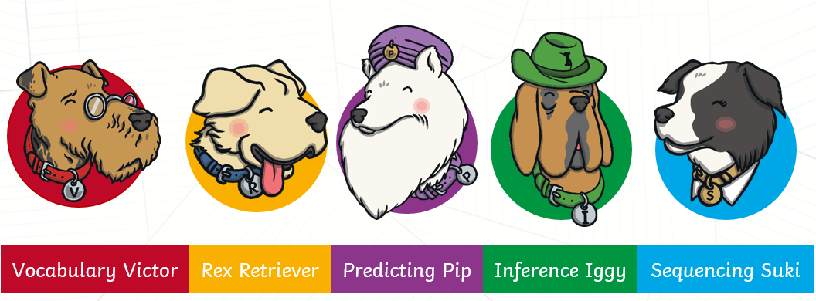
How do we implement this at Newdigate?
Comprehension in Year 2
In our guided reading lessons we focus on a text together.
We use “Reading dogs” to support comprehension
These can be developed in the ‘You Read to Me’ books by you!
Notes:
We may focus on a particular comprehension skill per day or possibly more than one. We use the dogs so that the children know explicitly what skill is being used. This will support their own reading comprehension skills and will help with comprehension papers as they progress to junior school and beyond.

Slide 8
How do we implement this at Newdigate?
Comprehension
We have an “end of day” story, where we look at 1 story over the week, asking appropriate questions about the story as necessary. In the Autumn term this is mainly orally, it progresses throughout the year.
Spring term,: we start guided reading lessons. If children still haven’t secured their phonetic sounds they will maintain working on this and developing the skills in an adult led group separately
High level vocabulary
Links to curriculum/topic work/English lessons
Year 1 and 2 have carefully chosen texts (poetry, diversity etc) whereas Year R are building upon their love of books but we will be including poetry, non fiction etc.
Notes:
Book and biscuits – Mixed year groups so older chn can support younger ones and embed their own comprehension skills through ‘talk’.
Re reading texts is key to strong comprehension skills and retaining a high level of vocabulary.
We cover books that enhance what we read across the curriculum and incorporate a range of genres.

Slide 9
How can you help at home? 2 book formula
I read this book to you’ (child focuses on decoding)
Read, read and read!
Reading challenge – 30 reads = a raffle ticket
“I read to you”Focus on decoding –
the framework says a child MUST be fluent in a given book before they can change it –so read and re read as much as possible (your child may use the pictures as a clue to the word – this is okay, however, guide them back to skill of decoding as a strategy for reading. As they become more advanced readers – there will be less pictures and they will need to use their phonic knowledge to feel secure about themselves as a ‘reader’ )
Please do write in the purple reading record –it helps us to see how your child is reading at home and we can respond as necessary.
Do come and talk to us if you have a question
‘You read this book to me’ (adult reading to child – language and comprehension)
First read - enjoy the story.
Later reads - the children can join in with key phrases, they can recall parts of the story, you can discuss the meanings of words and you will have modelled expression! You can ask questions on the bookmark!

Slide 10
Thank you for joining us Any questions?

