Slide 1

Year 2
Curriculum presentation

Slide 2
What we will talk about this evening
The purpose of this evening is to go over general information relating to Year 2 and to give you an overview of the curriculum coverage and end of year expectations.
Please do stop me and ask questions at any time!

Slide 3


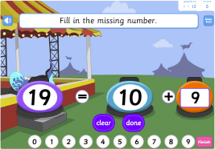



General information
Reading books
Homework
Education city
Year 2 leaders
Interactive learning – twitter!
Growth mindset
Marvellous me!
Outdoor learning
P.E
Parent helpers
Pick up and drop off
News book
Notes:
Fruit etc monitors worship leaders helping younger children taking the lead in school events
Opportunities to show growth mindset in lessons. Learning leader languards
Outdoor learning – key for socialising and getting along/working things out – both learning and with each other/physical side very important
Parent helpers – reading sewing any expertise
News book – support spoken language side of the curriculum/answering and asking questions/reading other than books/newspaper club

Slide 4
Assessment overview
The aim is that all children will meet the ‘End of Year Expectations’ at the ‘expected’ level
Emerging
Expected
Exceeding
Notes:
We track regularly and have cycles of intervention for those chn who need support. We report attainment in school report.
SATS informs our judgement but it is teacher assessment.

Slide 5

Reading
Guided Reading once a week for half an hour.
Guided Reading tasks
Benchmarking every half term.
Parent readers
Daily readers
Technical ability
Comprehension
How do we assess your child’s reading?
Notes:
Guided reading skills – inference/prediction/scanning for information/discussing meanings of words as well as technical side – phonics/grammar/expression

Slide 6
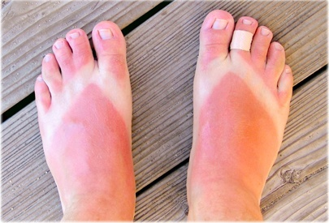
Example of an Inference based guided reading task
Inference Questions: Name two countries that the person could be in. Where did the person go? What mode of transport did they use there? What happened to the toe?

Slide 7
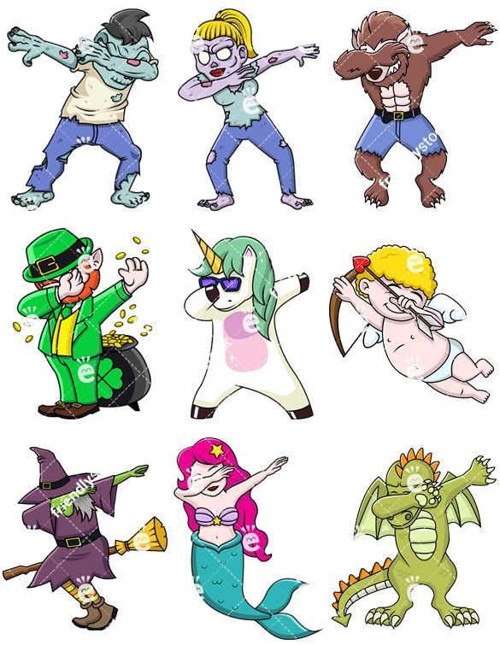
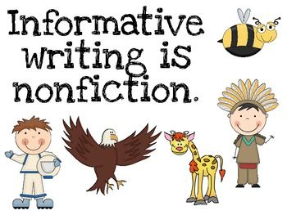


Writing
Writing from across the curriculum is used for assessment
A range of fiction, non-fiction and poetry
Meaningful for the children – topic related
Opportunities for peer and self assessment and editing

Slide 8

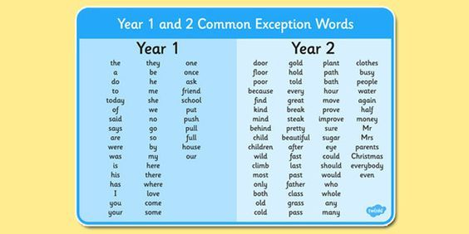
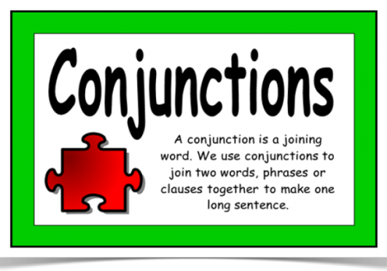
Writing
Writing sentences that include:
Using their knowledge of phonics and spelling rules learnt in Year 2
Writing some common exception words
Using conjunctions
Using simple forms of punctuation

Slide 9

Grammar
Full range of simple punctuation
Adjectives
Verb
Noun
Proper noun
Adverb
Correct use of tenses
Different types of sentences

Slide 10

Handwriting
Developing a continuous cursive handwriting style
Correct sizing of letters
Correct formation of letters
Using the line properly
No reversal of letters – b and d
No inclusion of capital letters in the middle of words or sentences
Handwriting within English lessons but also taught discreetly at least 3 times per week

Slide 11
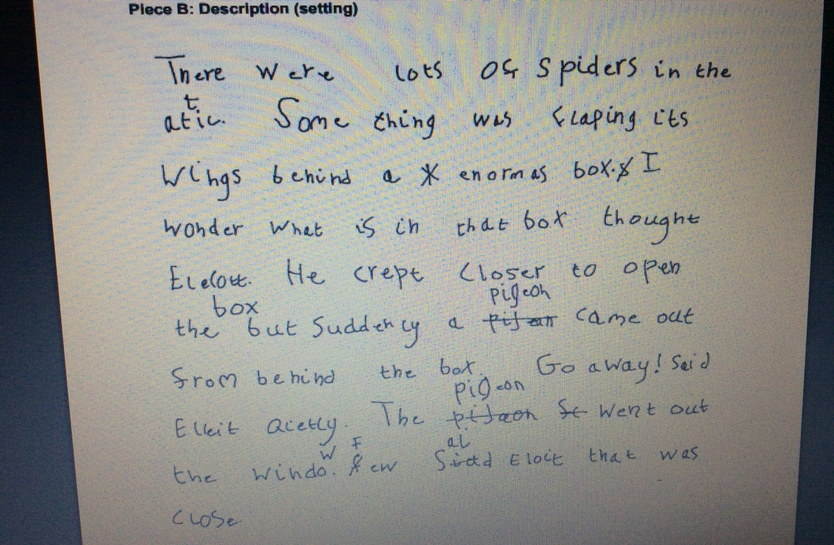
Example of pieces of work at the ‘expected’ level

Slide 12
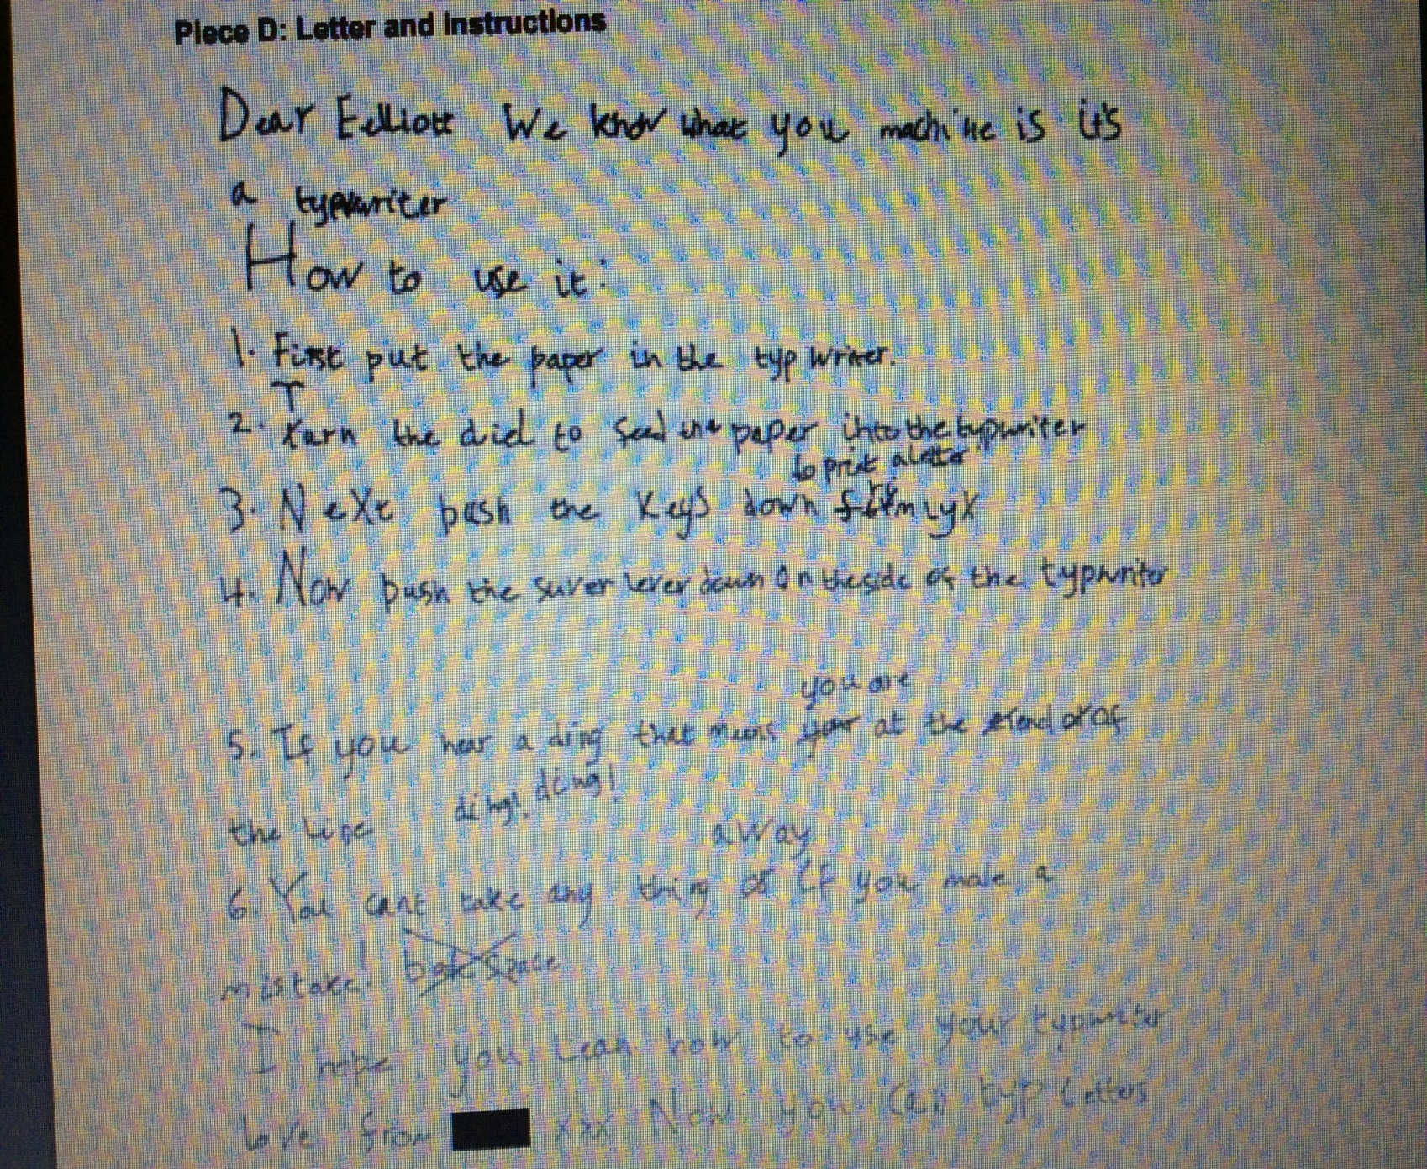

Slide 13


Phonics and spelling
Phonics
We recap speed sets 2 and 3 from our RWI phonics programme in the first half of Autumn term.
WHY?
No Nonsense Spelling
We move onto the above programme from Autumn 2.
Some of the programme involves learning about prefixes, suffixes, homophones, alternative spellings and contractions.
(or = au aw)
and pronunciations
(c – can sound like an s as in circus) and spelling patterns
Le al el endings
(puddle muddle petal metal tunnel funnel)

Slide 14
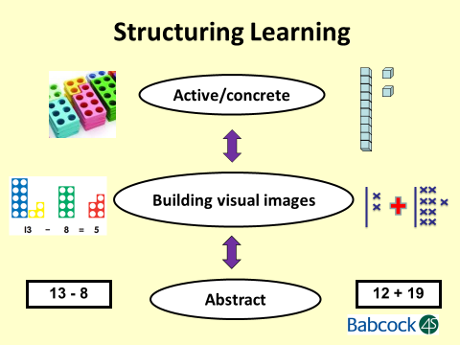
Maths

Slide 15
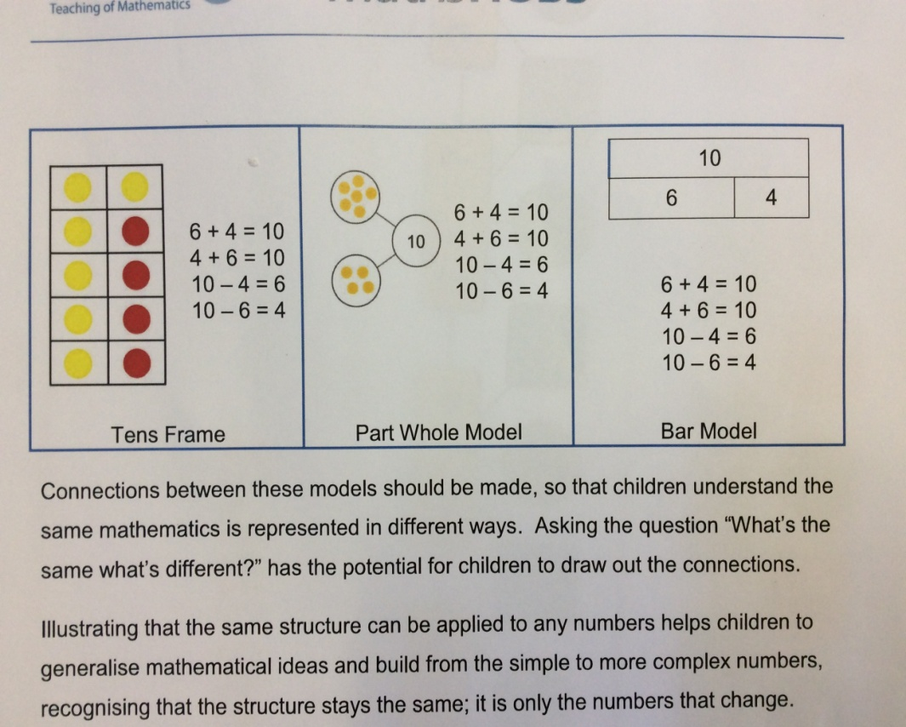
What do the children need to be able to do in Maths by the end of Year 2?
Count in 2’s, 5’s, 10’s and 3’s
Become fluent in all four operations
Work with numbers up to 100
Time
Shape including lines of symmetry
Measure – length, height, weight, capacity
(ml litres cm’s metres grams and KG)
Problem Solving (Reasoning)

Slide 16
All children cover the same content but work at their own fluency and reasoning level
We offer the children ‘self selection’
Different ‘stars’ (1, 2 or 3) for different levels of challenge and the children choose!
This encourages children to feel confident and in control.
Children are expected to challenge themselves when they can.

Slide 17



Assessment and Marking
Tickled pink
Green for growth
Purple polishing
This marking criteria is embedded throughout the school and the children are very familiar with it.
The children have a ‘Success Checklist’ for every lesson and they know they have been successful if they are able to complete everything on the list.

Slide 18
Notes:
Over past two years have been fortunate to have small dedicated team of volunteers who come to these days with whole family – including grandparents, aunts, uncles, siblings. We have Yr 2 and Yr 1 chn who are ‘out and about’ leaders who help run the morning – its only for 2 hours 10-12 but makes a huge difference to our learning environment. In past sessions we have planted the orchard, stained fencing, benches, clear the environmental area(pond) and build 2 large bug hotels, erected fencing, dug out and planted out phase 1 of sensory garden and re-designed the kitchen garden. Out next session we be held end of oct/beg nov. We hope to begin phase 2 of sensory garden, lay the paving on phase 1, finish the kitchen garden, move in our school ‘chickens’ and re stain the fencing around the environmental area. None of this is possible without your help.

Slide 19

Thank you for making the time to come this evening.
Questions?

